Slide 1
Board Game Maker
Aaron, Jackson, Sophia, Landon

Slide 2
Why This Project?
We wanted to create a tool that people could use to create their own ideas for board games and then play those games with others.
Most other game makers that exist rely heavily on the honor system, while this board game maker will be able to enforce rules on the players that the users can create.
The users of this software will be able to define their own rules using a simple if-then-else scripting language, this offers a wide variety of different rules that the user can create, making this project very versatile.

Slide 3
What Have we Completed so Far?
So far, we’ve made much of the backend, including the classes, code for running the scripting language rules, and moving the pieces on the board internally.
We’ve also worked on the frontend for the game creation process, including the creation menu, type editors, button editor, and the scripting rule form.

Slide 4
User Experience
When creating a game, the user will be able to create a board of any size, and choose from multiple types.
The user will be able to set the rules and behaviors of tiles, pieces, buttons, etc using the if-then-else pseudo language.
The user will be able to choose what piece types and how many pieces each player has at the start of the game.
When a user has completed their game, they will be able to save it allowing them to play their game at any time.

Slide 5
Planning
Our minimum goal is to add enough features so that game creators can create games similar to chess and checkers. This involves customization of the board, the pieces and how they move, and to a certain extent the way turn progression works.
We also intend to make it customizable enough that, using the same scripting language, games like Tic-Tac-Toe and Connect Four can be made.
If we choose to continue working on this after the end of the semester, we intend to add enough features so that games like Battleship and games like Qwirkle can be made as well.

Slide 6
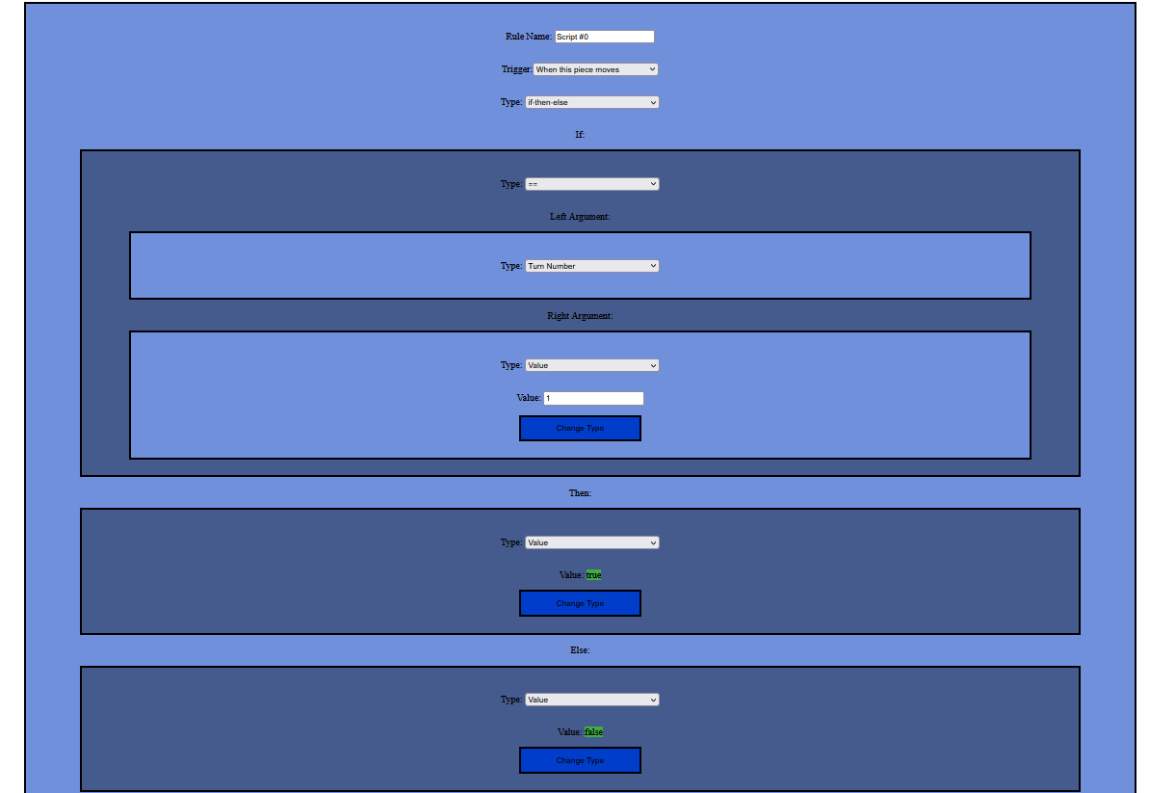
Backend
The code includes the following classes, among others: “ScriptingRule” to hold the scripting language rules, “Piece” and “Tile” to represent individual pieces and tiles, “PieceType” and “TileType” to represent types of pieces and tiles (these, not individual pieces and tiles, include ScriptingRules), “Board” which holds the tiles, “GameState” which holds an in-progress game (including a board and an array of pieces), etc.

Slide 7
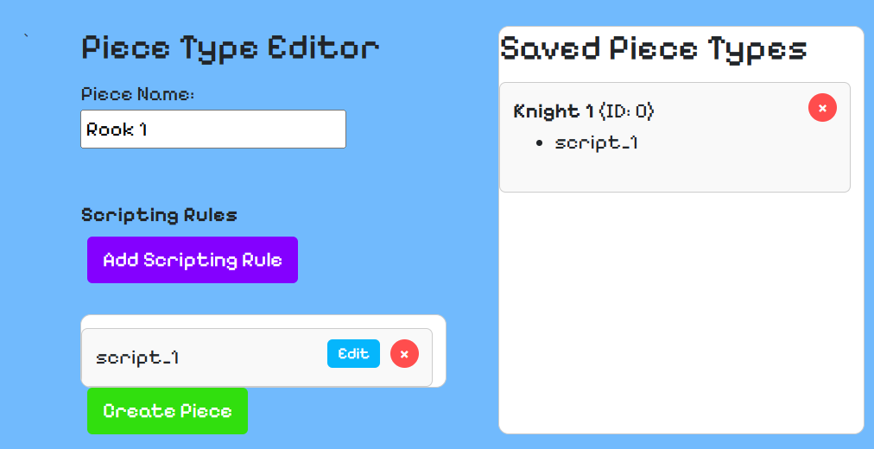
Frontend
So far on the frontend we have been creating forms for all of the
UI screens we need, the PieceTypeEditor, TileTypeEditor, and ScriptingRuleEditor, etc.
We have attempted to make all of
these forms as friendly to the user
as possible, allowing them to have
complete control over the game
they make.

Slide 8
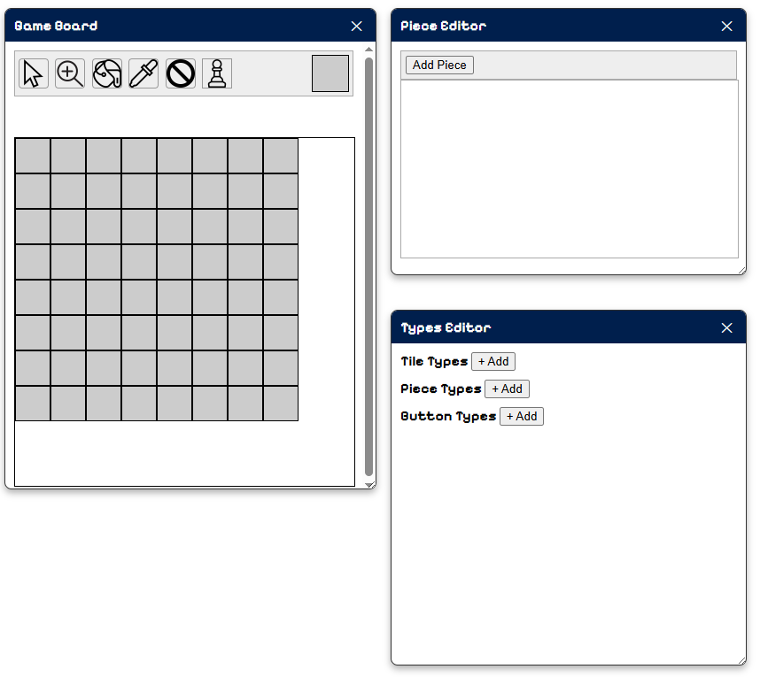
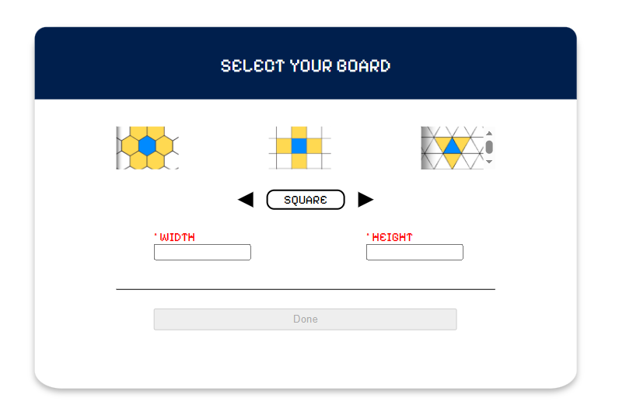
Frontend
Here are some more examples of the UI:
Create Menu

Slide 9
Things we still plan to add
So far, we’ve been focusing on the backend and the game creation UI. We’ll start on making the UI for the gameplay of the saved games soon.
Once we do that, we’ll test the project by creating some basic games within it and making sure they work.

